Slide 1
e-Project Cosy Airconditioner

Slide 2
FPT APTECH HANOI
MENTOR: QUANG NGUYEN VAN

Slide 3




TEAM MEMBERS
1. LÊ KHẢ ĐỨC ANH
2. NGUYỄN TRẦN QUÝ
3. LÊ HỮU HIỆP
4. TỐNG MINH ĐỨC

Slide 4
Introduction
The thirst for learning, upgrading technical skills and applying the concepts in real life environment at a fast pace is what the industry demands from IT professionals today. However busy work schedules, far-flung locations, unavailability of convenient time-slots pose as major barriers when it comes to applying the concepts into realism. And hence the need to look out for alternative means of implementation in the form of laddered approach.
The above truly pose as constraints especially for our students too! With their busy schedules, it is indeed difficult for our students to keep up with the genuine and constant need for integrated application which can be seen live especially so in the field of IT education where technology can change on the spur of a moment. Well, technology does come to our rescue at such times!!
Keeping the above in mind and in tune with our constant endeavour to use Technology in our training model, we at Aptech have thought of revolutionizing the way our students learn and implement the concepts using tools themselves by providing a live and synchronous eProject learning environment!

Slide 5
TECHNOLOGY
HTML5
CSS
JAVASCRIPT
GEOLOCATION
BOOTSTRAP
JQUERY

Slide 6
WEBSITE STRUCTURE
We build total 19 websites: Homepage, Product, About Us, FAQ, Cart,…

Slide 7
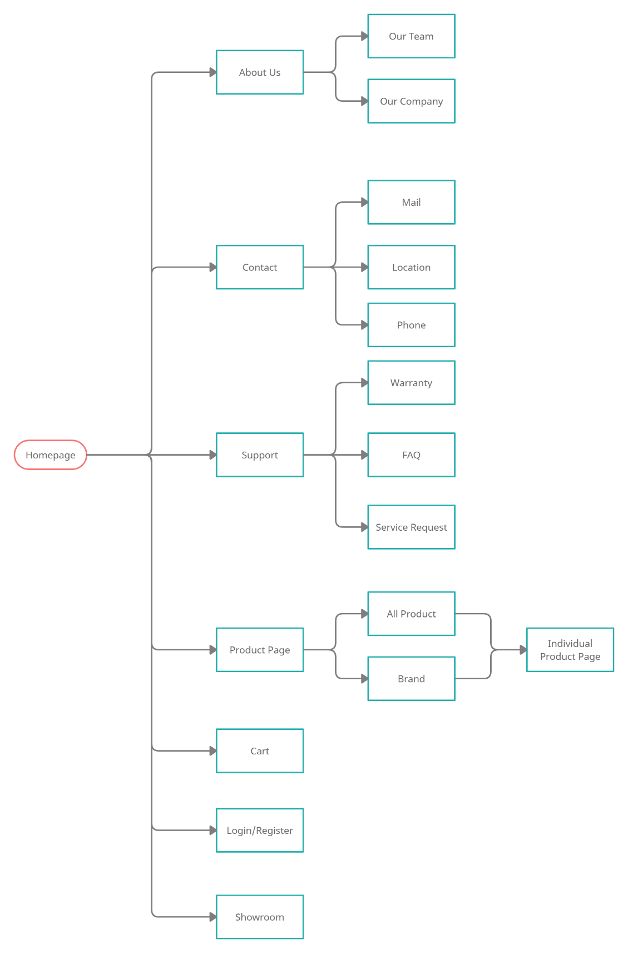
SITE’S MAP

Slide 8
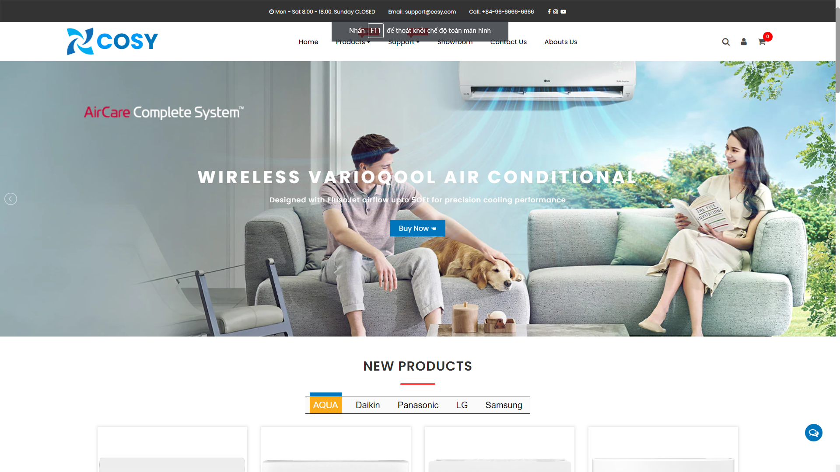
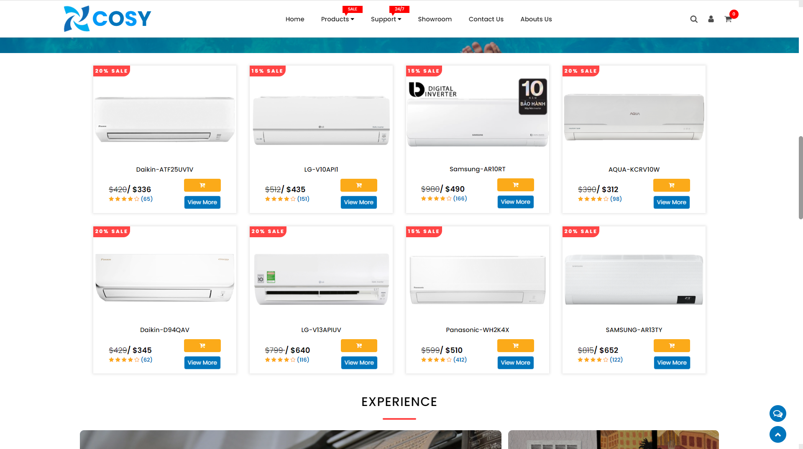
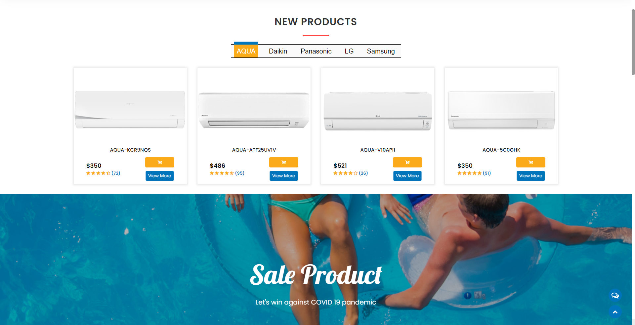
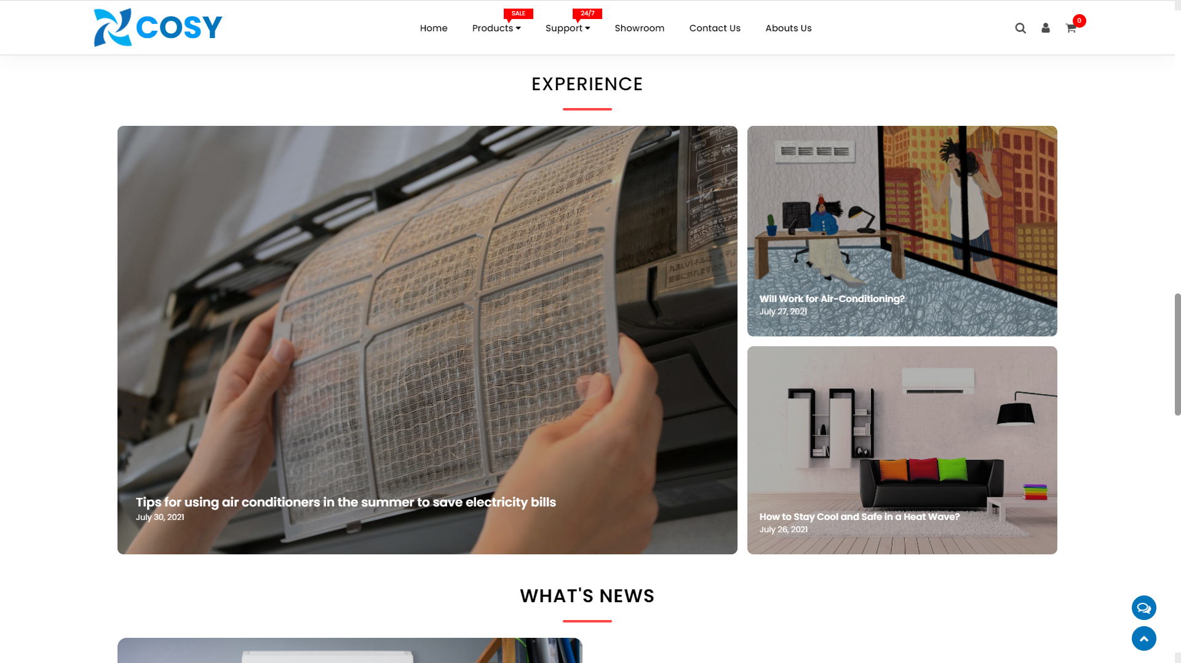
HOMEPAGE

Slide 9
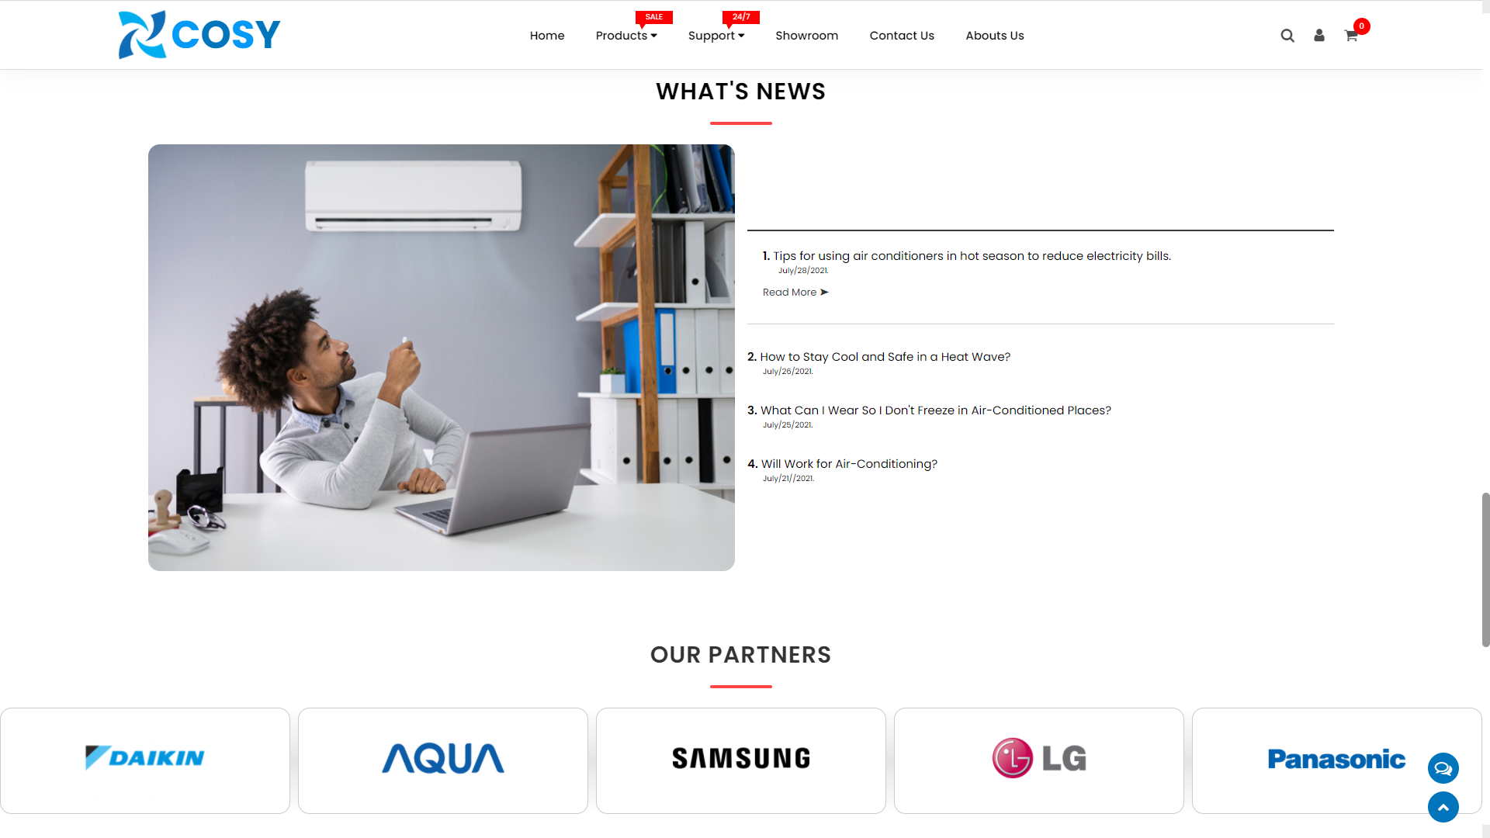

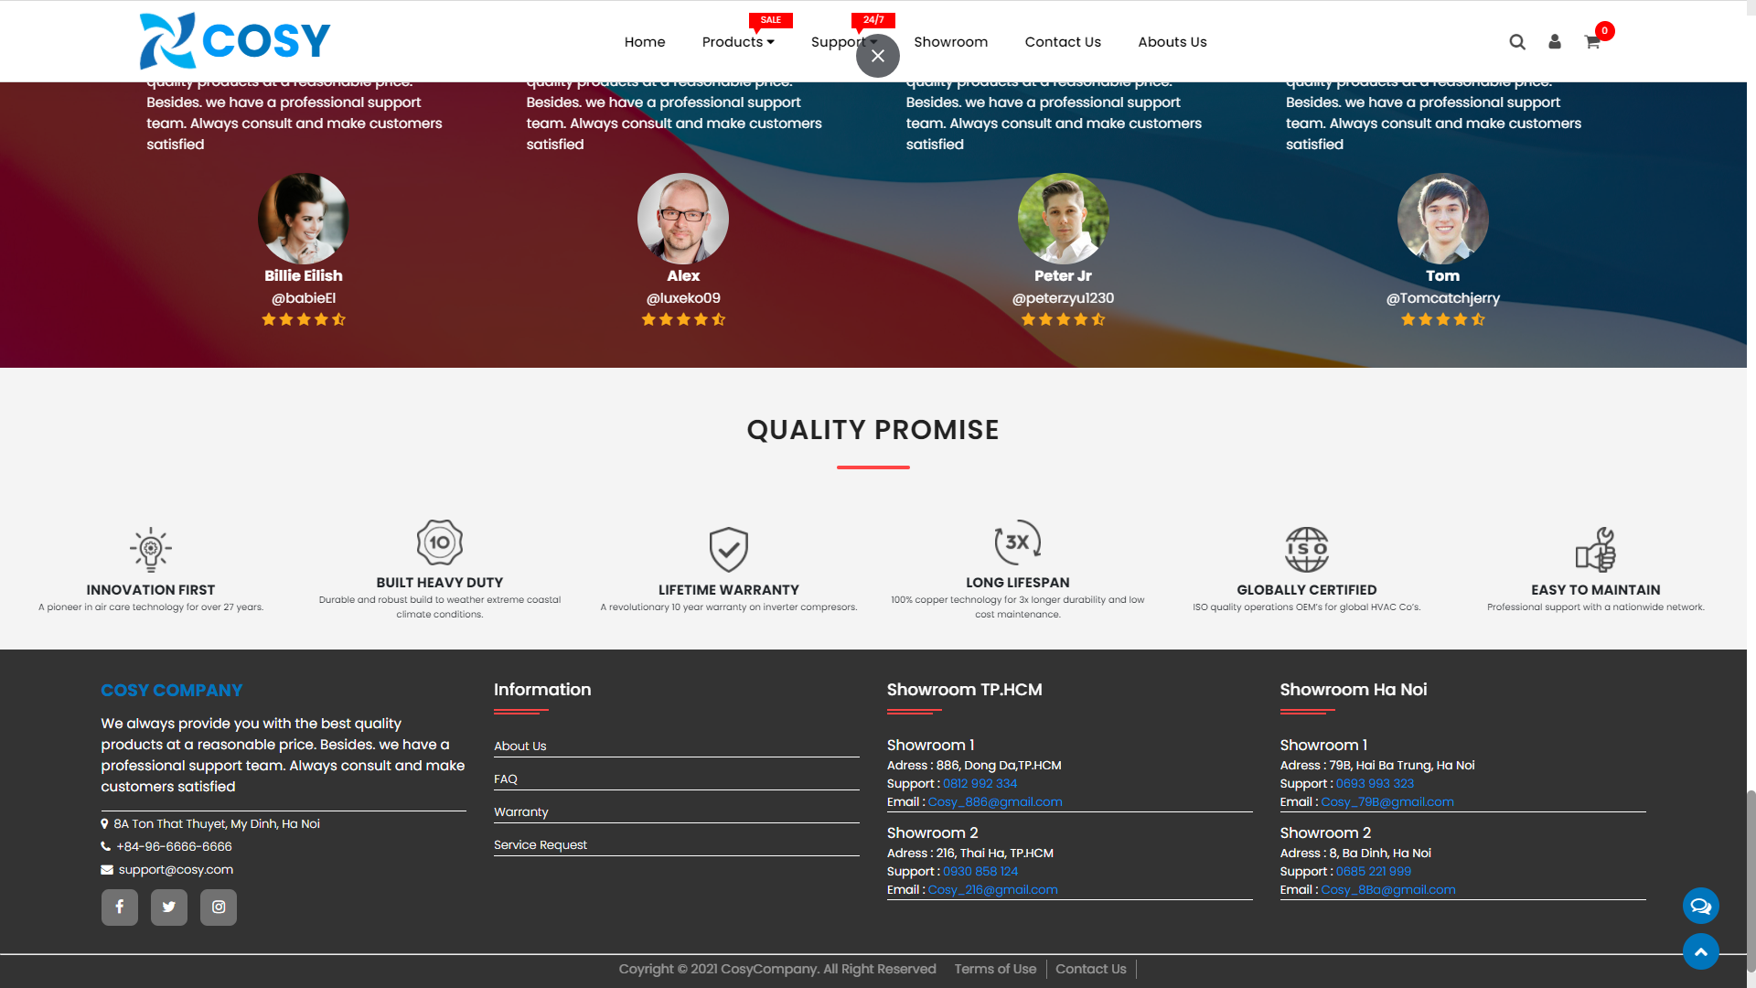
HOMEPAGE

Slide 10
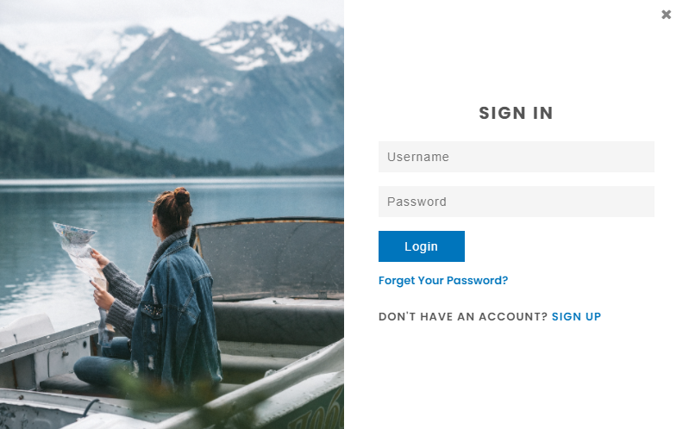

HOMEPAGE
We have login/register button on website’s top right corner to help customer login or register.

Slide 11
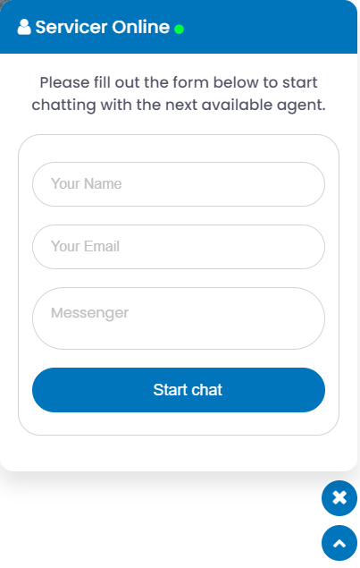
HOMEPAGE
We also build quick chat bubble and scroll to top button at right bottom corner.

Slide 12
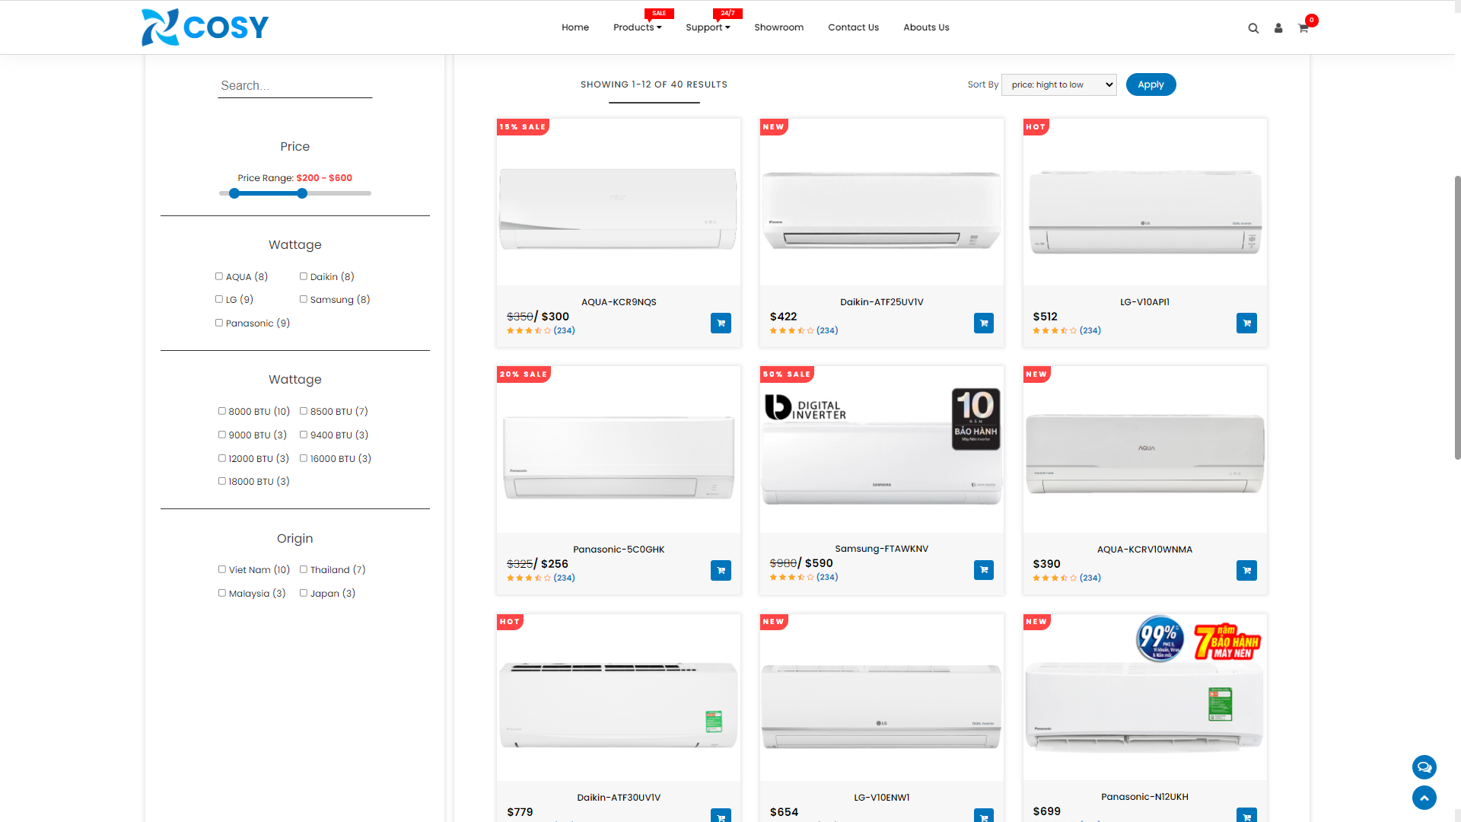
PRODUCT PAGE
We divide product page into 2 section:
Left: Filter
Right: Products

Slide 13
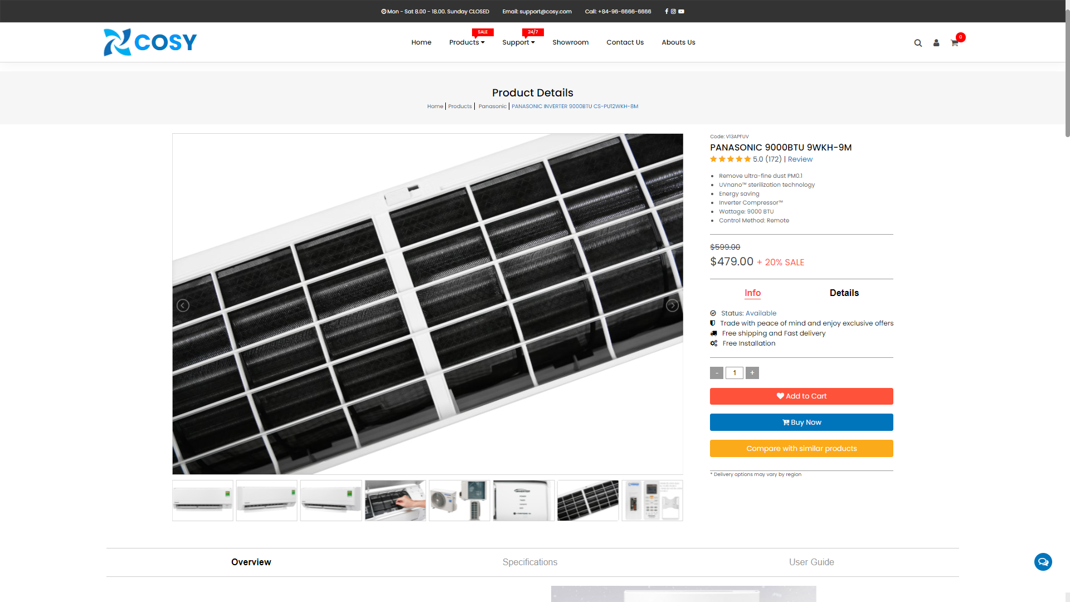
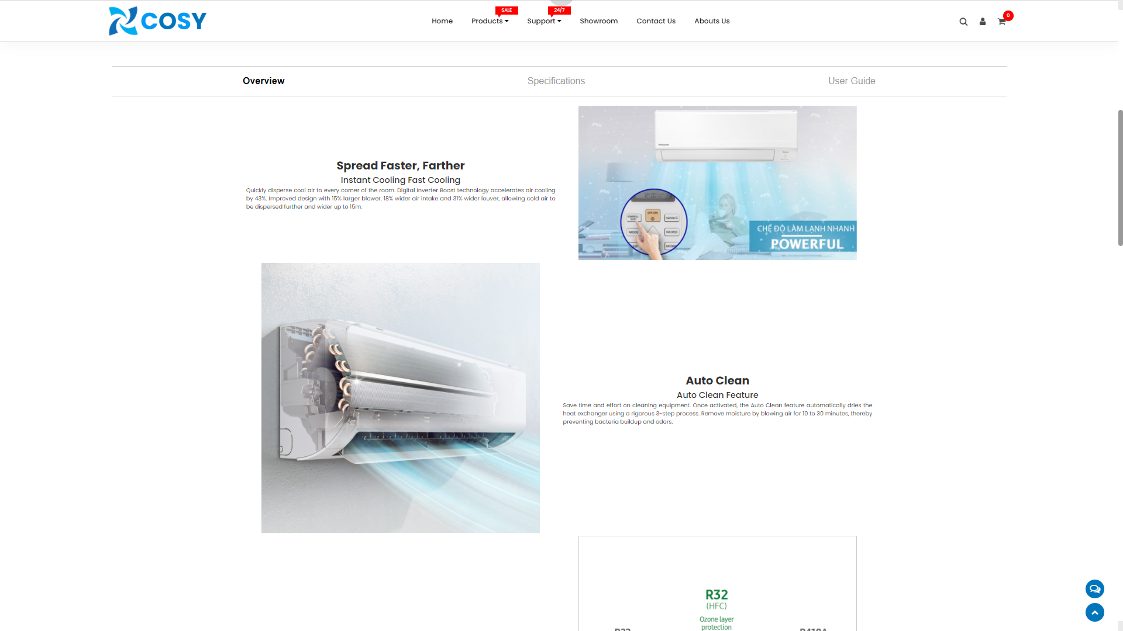
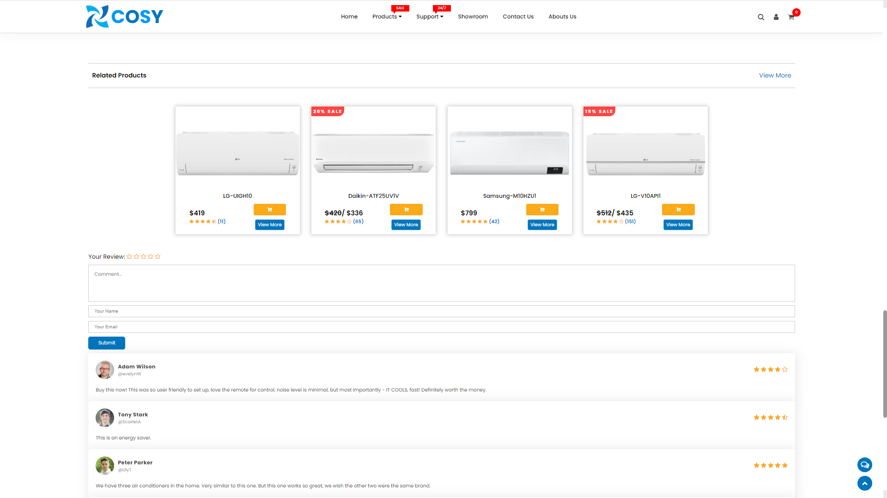
INDIVIDUAL PRODUCT PAGE
Display information to help customer know more about product and they can compare it with others.

Slide 14
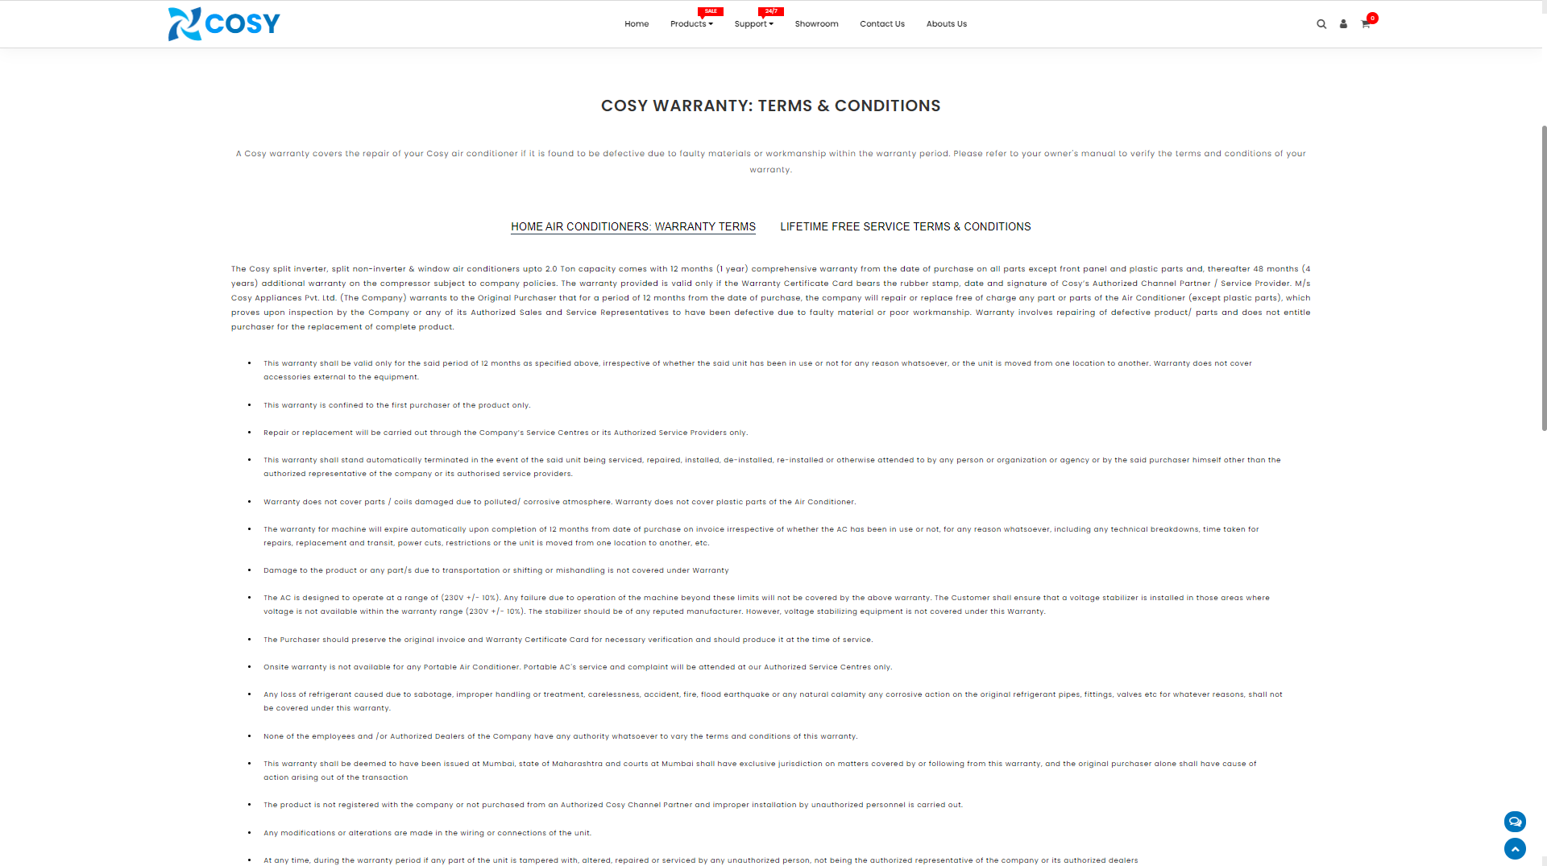
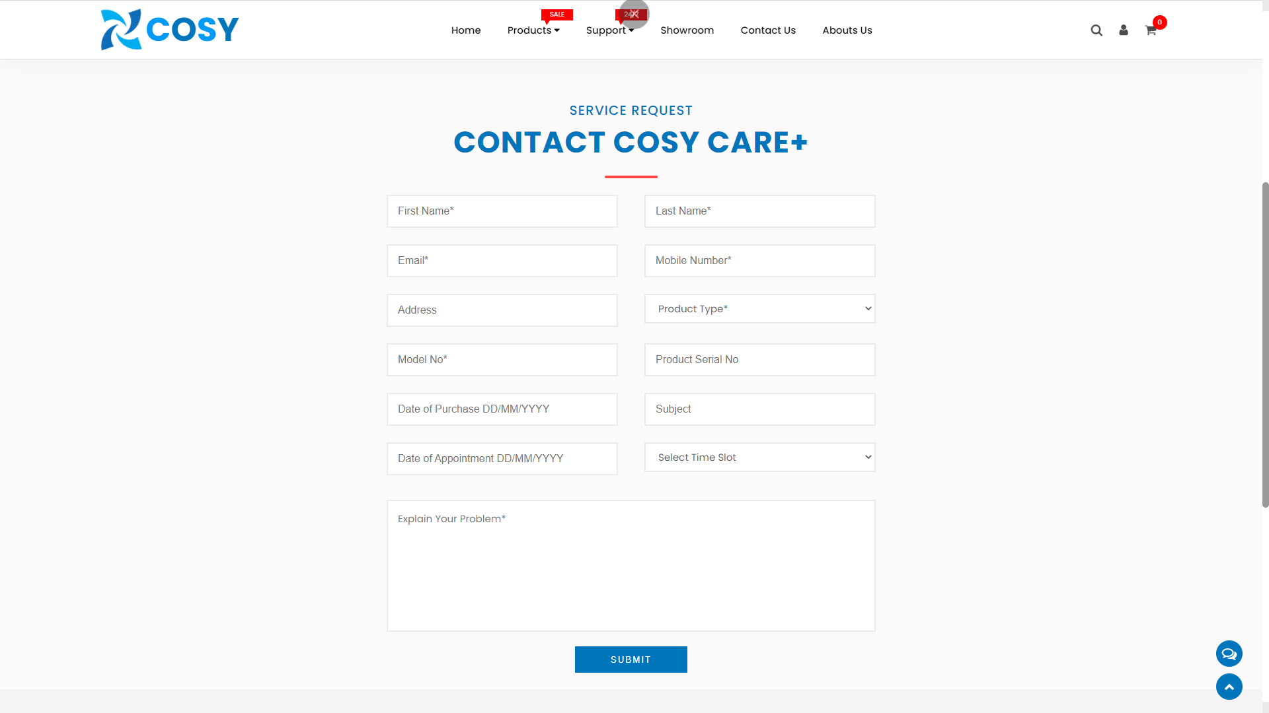
SUPPORT PAGE
Warranty page:
Our term & conditions.
Service Request:
For customer to call
help.

Slide 15
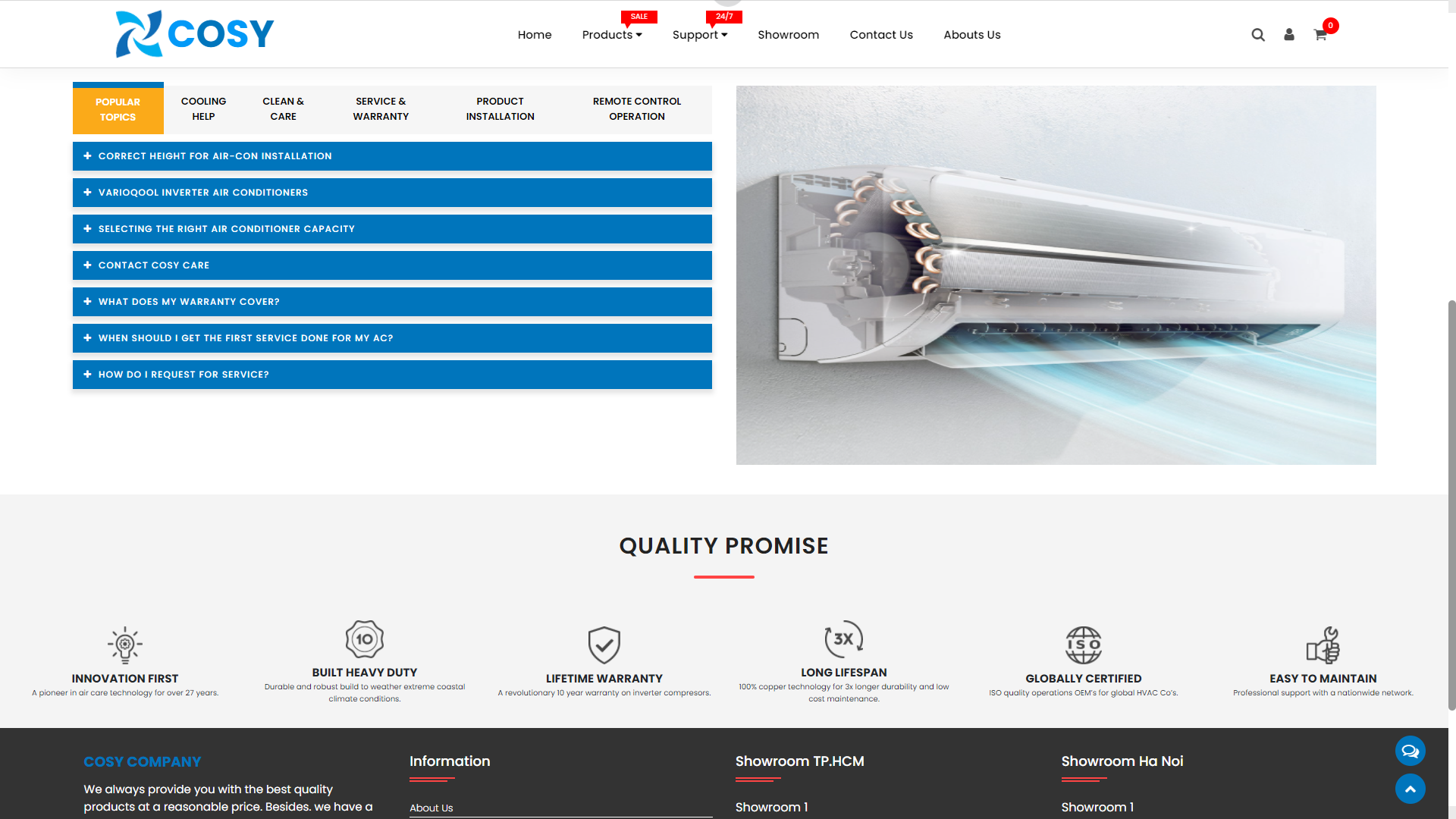
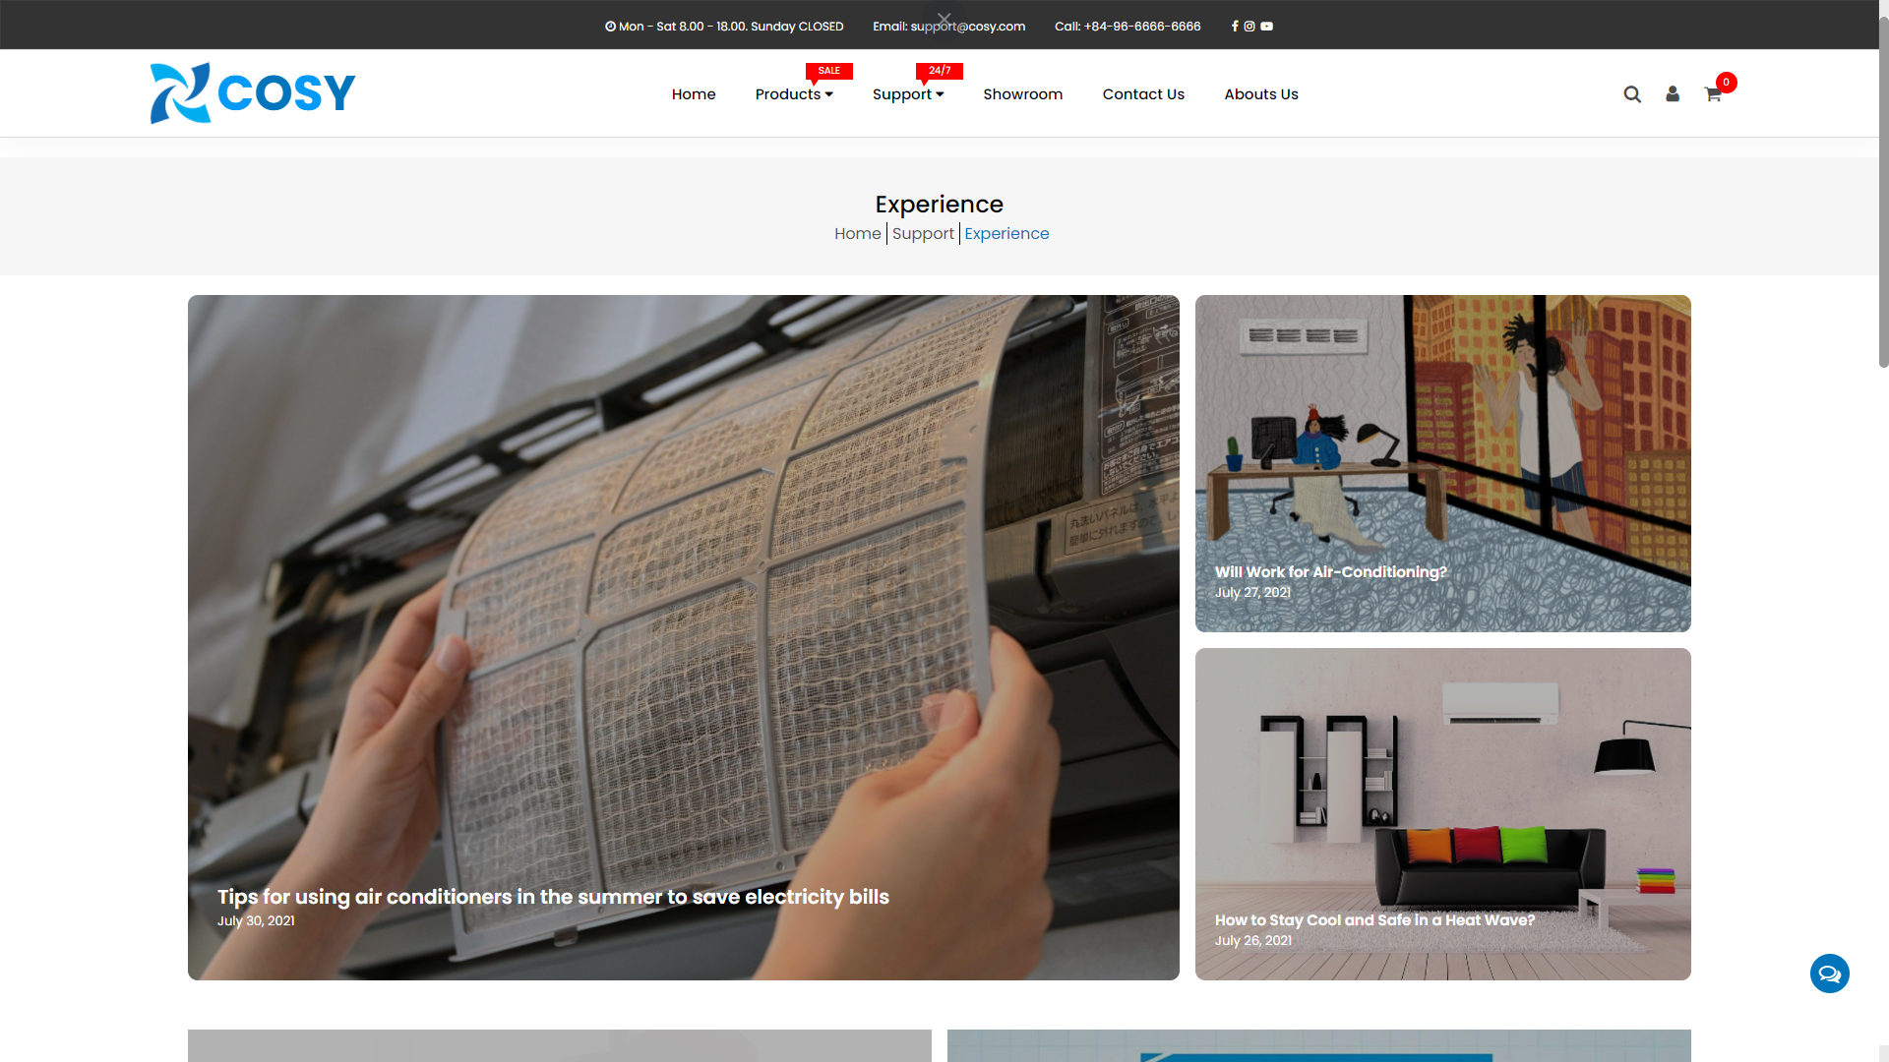
SUPPORT PAGE
FAQ:
Answer customer’s
question.
Experience:
Tips & experiments.

Slide 16
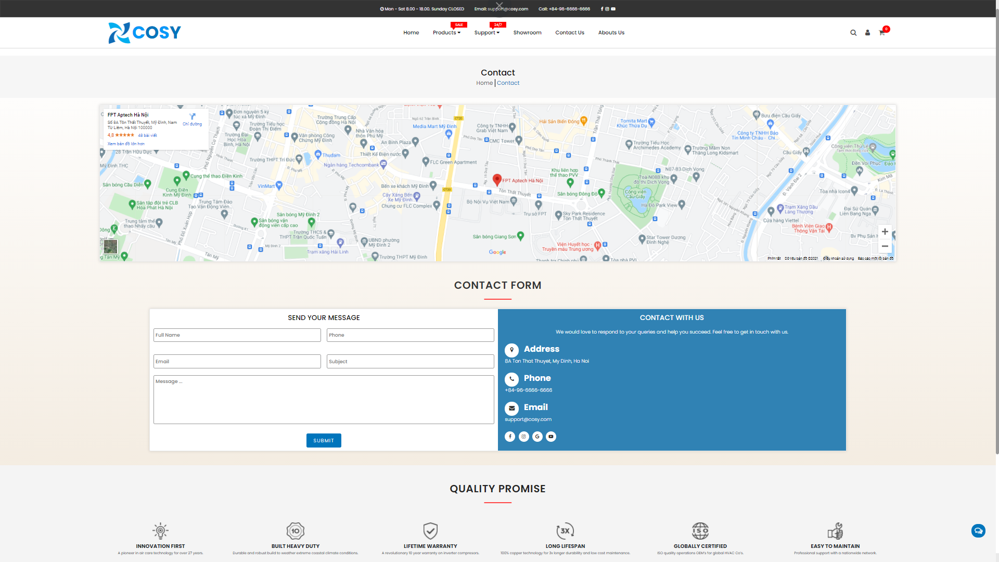
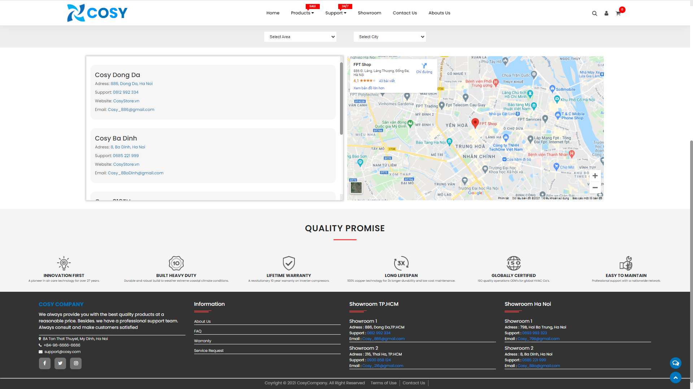
SHOWROOM & CONTACT US PAGE
Showroom:
Our retailer location.
Contact:
Company address and
contact fomr.

Slide 17
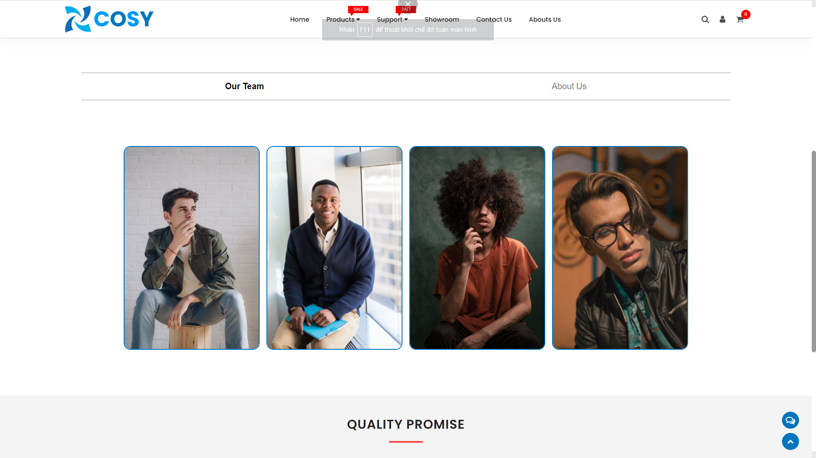
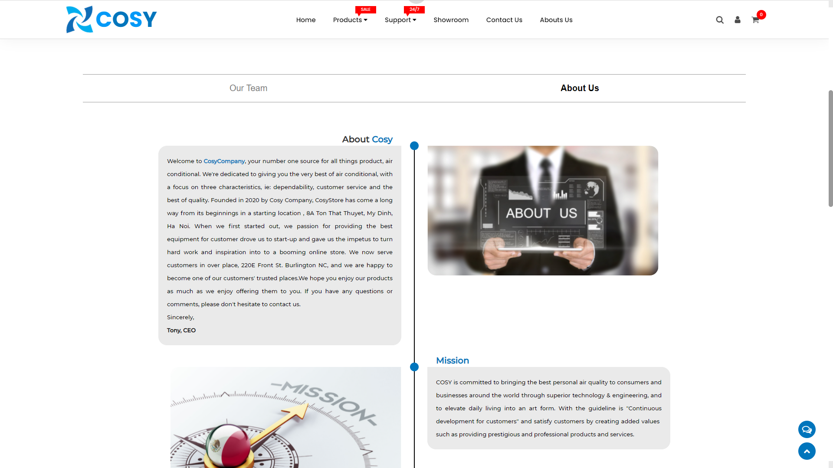
ABOUT US PAGE
About our team.
About our company.

Slide 18
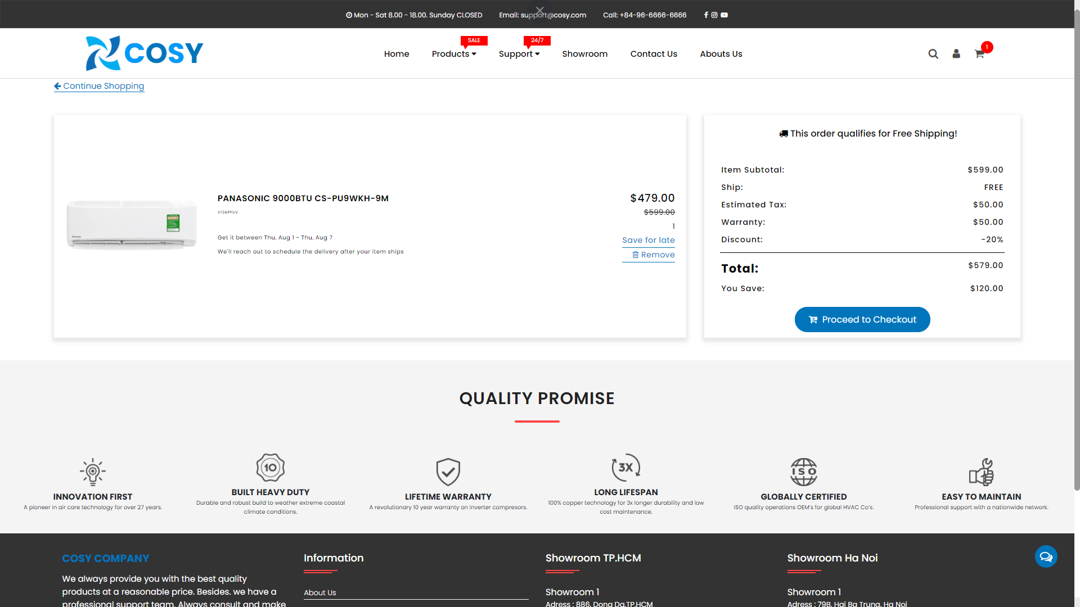
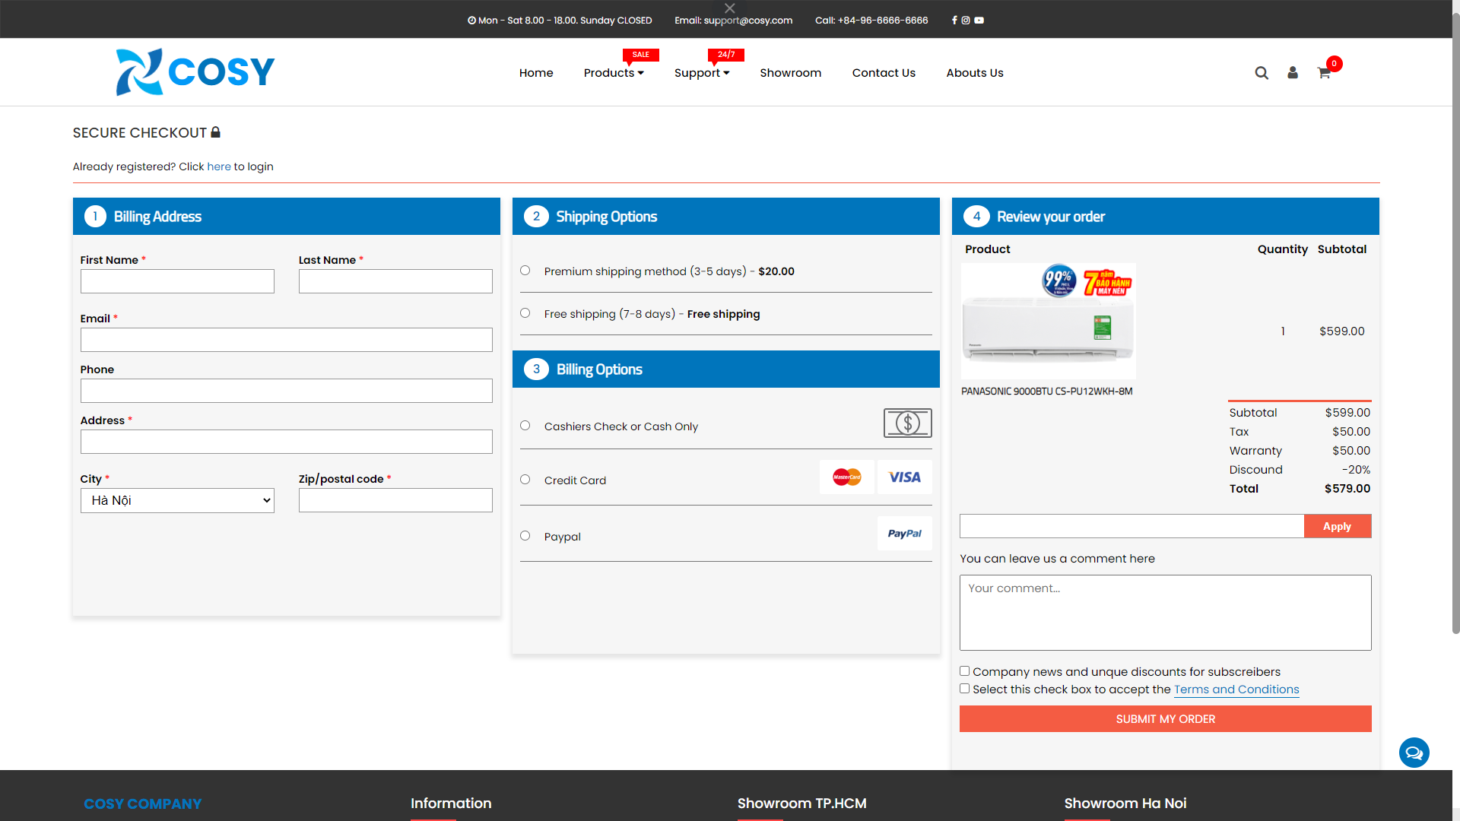
CART & CHECKOUT PAGE
Cart:
Where to review chosen
product.
Checkout:
Finish shopping.

Slide 19
THANK YOU!

